Slide 1
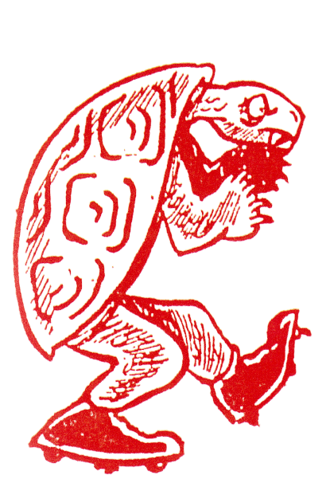
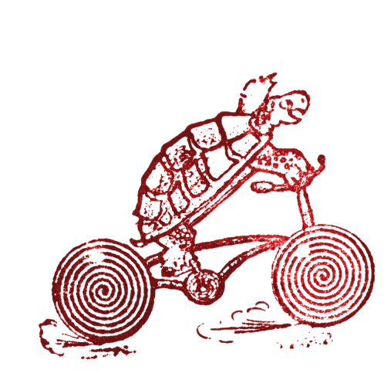
Testudo+
Man of Steel Team

Slide 2

Our Main Message – What We Want to Convey Through Our Presentation
Findings
Recommendations
Key Insights
What We Learned
Important Discoveries

Slide 3

A Better Way to Register for Classes
Why did we choose to redesign testudo.umd.edu?
Every member of our team has experienced frustration while registering for classes at UMD. The online portal for doing so runs on an antiquated system architecture with a user interface to match. The page is cluttered, unintuitive, and experiences long periods of down time.
Man of Steel Group believes that Maryland’s flagship university should fearlessly update their aging systems; starting with one of the most frequently used.

Slide 4

Background
Problem Statement:
The website testudo.umd.edu is outdated and not user friendly.
As a result, students often have trouble navigating the webpage and registering for classes.
The pandemic only heightened the need for people to interact with administrative tasks via an online portal.
Therefore the University of Maryland should have a modern, easy to use portal for all students, faculty, and alumni to access information.

Slide 5

How ?
Research Question:
What changes can be made in order to make registration easier for students?
How many students have problems registering for classes in the Testudo Drop/Add application?
Where does the user begin to have problems?
How likely is the user to get outside help with the Testudo registration process?

Slide 6

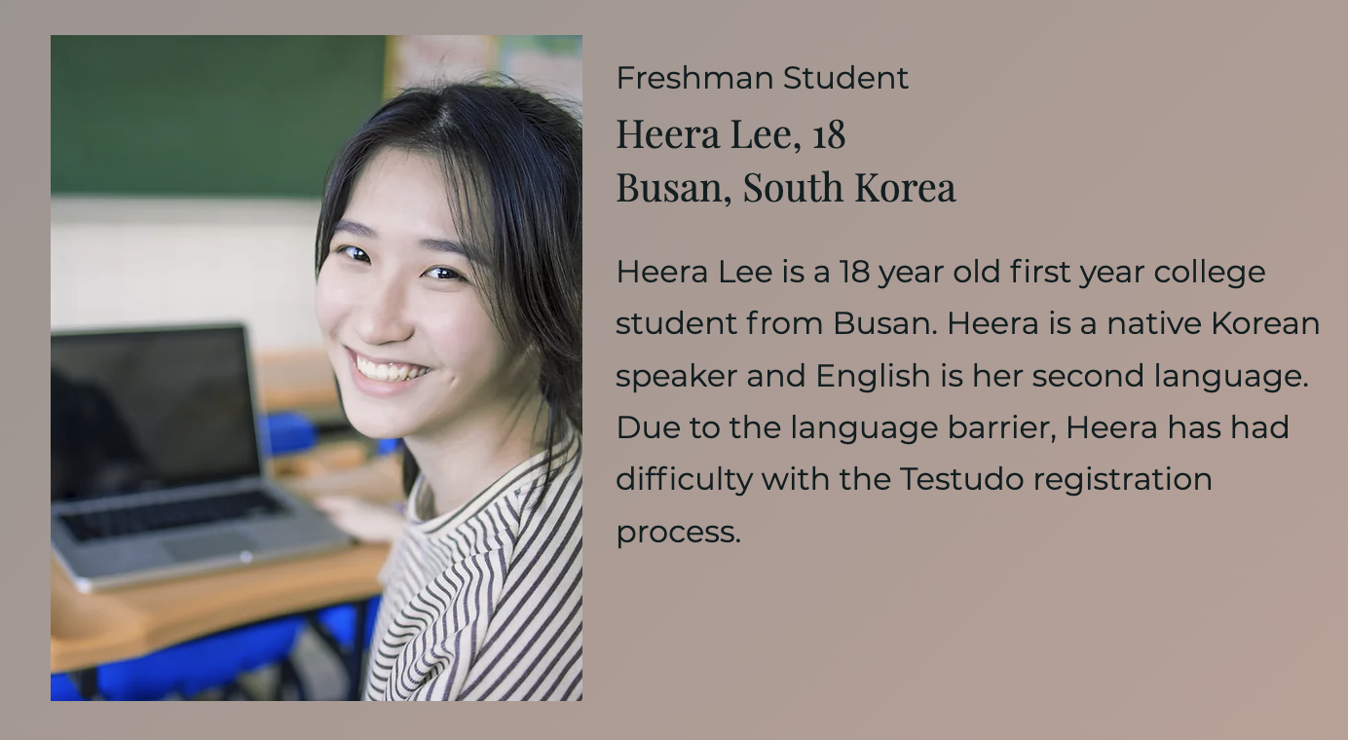
Personas

Slide 7
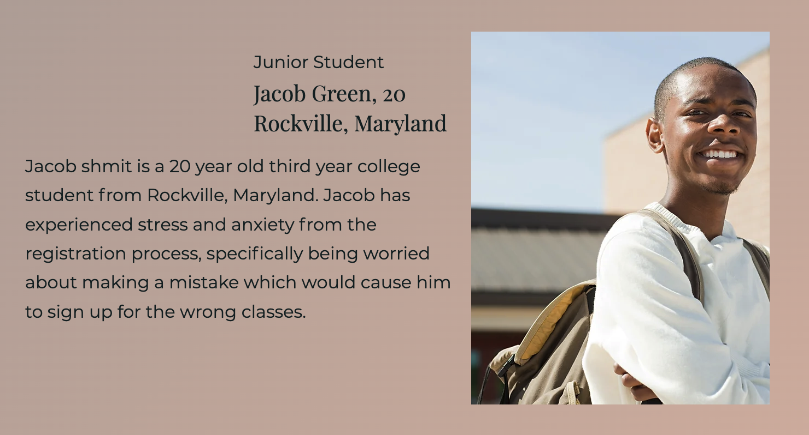
Personas

Slide 8
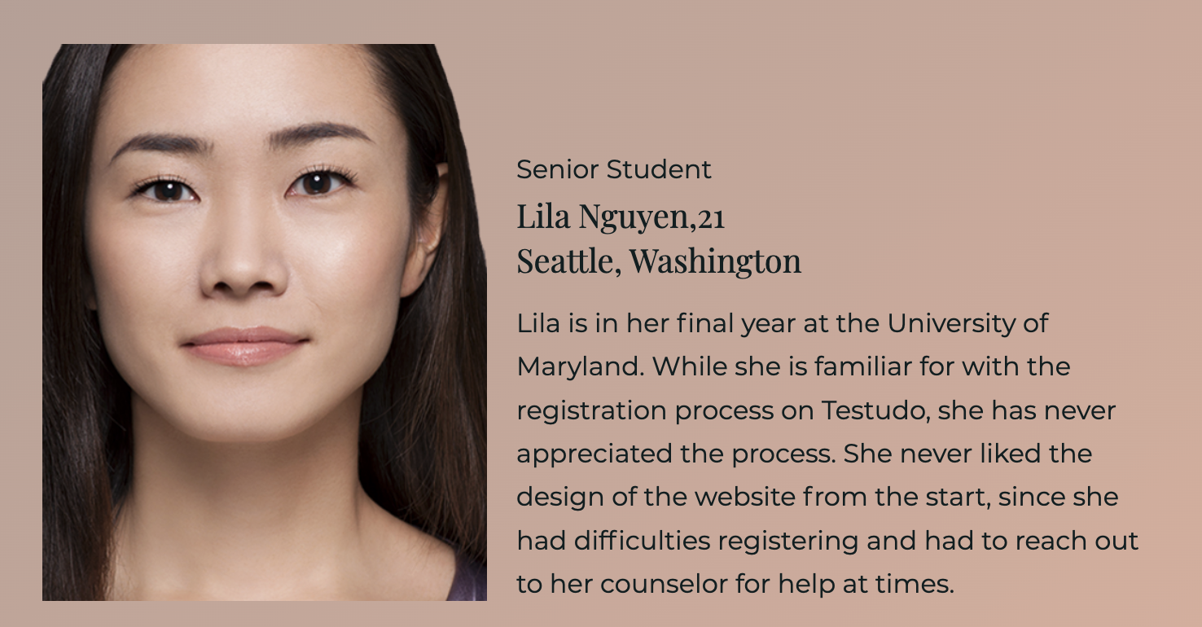
Personas

Slide 9

User-Centered Design Process
How can we make the user- centered design?
Understanding the audience exploring
Prototyping testing potential solutions

Slide 10
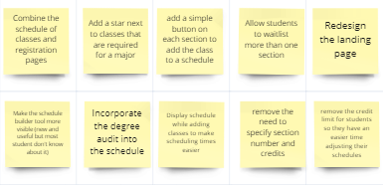
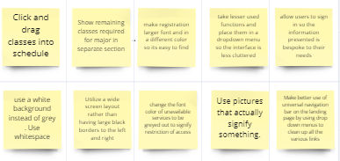
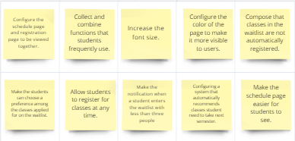
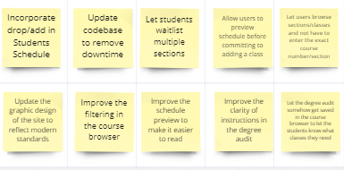
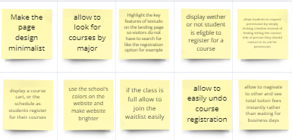
Brainstorming
10+10 Design Thinking

Slide 11
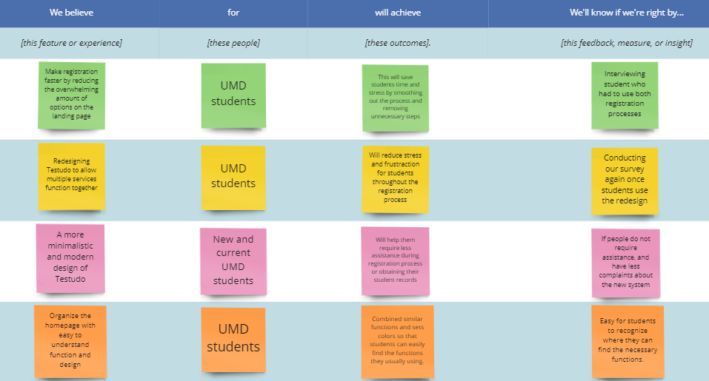
User Assumption

Slide 12

Interview and Survey
We conducted and online survey
Target Audience
UMD students
Google Survey given outside of STAMP to get a variety of students
48 participants
Questions
Likes and dislikes of Testudo
Rating of Testudo
Suggested improvements
Various other questions

Slide 13
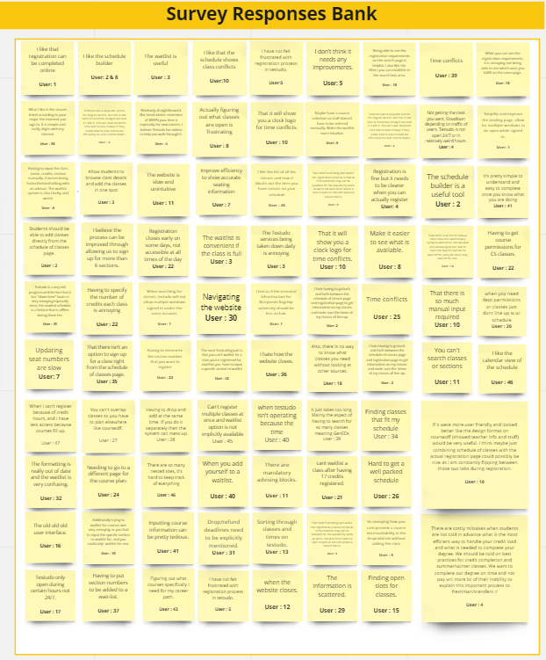
Other Responses

Slide 14
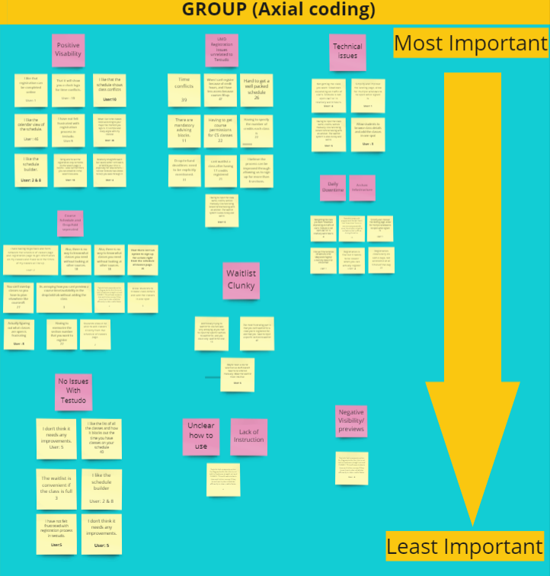
Axial Coding
Most Important -> Least Important
Positive visibility
UMD Registration Issues unrelated to Testudo
Technical issues
Course Schedule and Drop/Add separated
Daily Downtime, Archaic Infrastructure
Waitlist Clunky
No Issues With Testudo
Unclear how to use, Lack of Instruction
Negative Visibility/previews

Slide 15
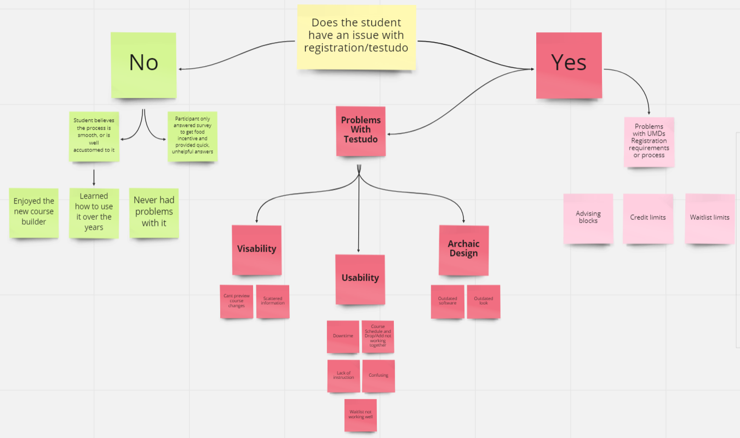
Affinity Diagram

Slide 16
Affinity Diagram - Yes or No

Slide 17
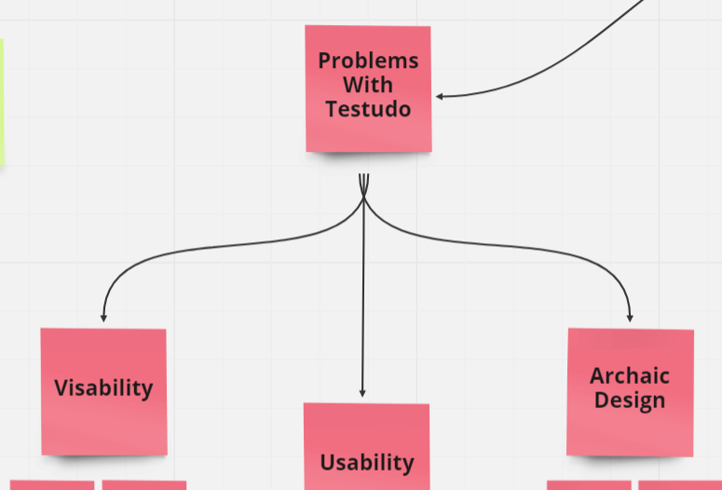
Affinity Diagram - Design Problems

Slide 18
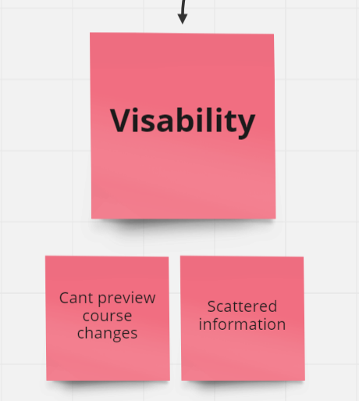
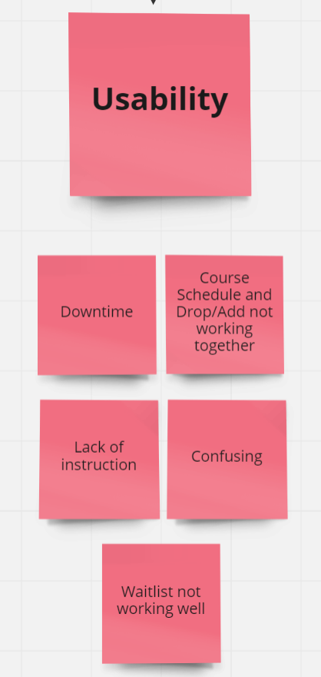
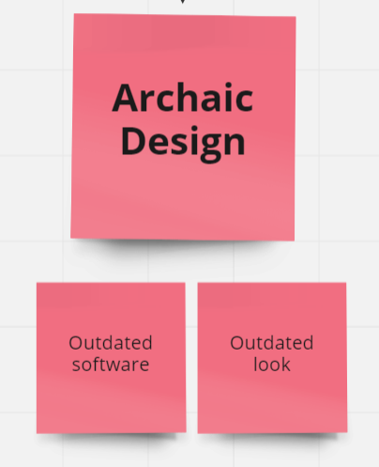
Affinity Diagram - Three Main Flaws

Slide 19
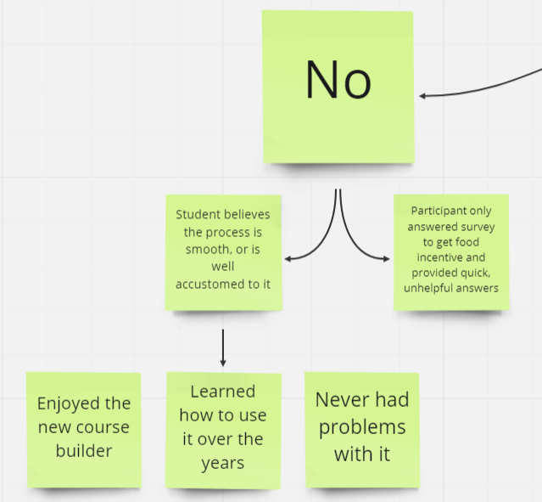
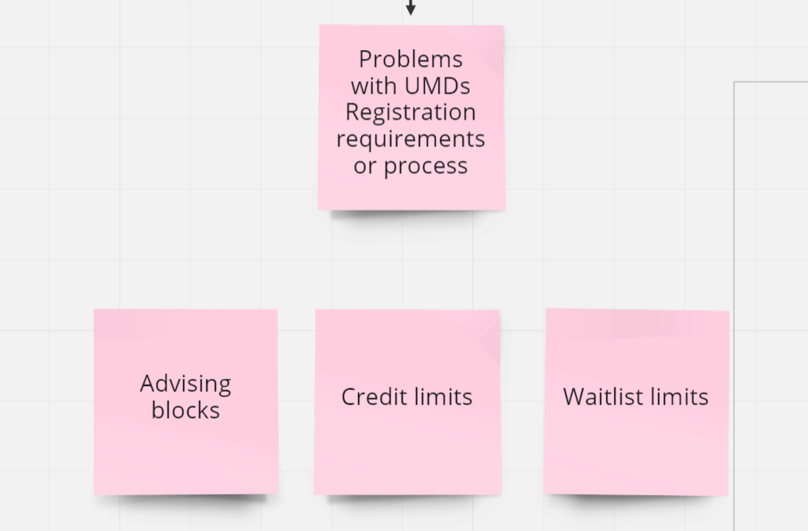
Affinity Diagram - Alternatives

Slide 20
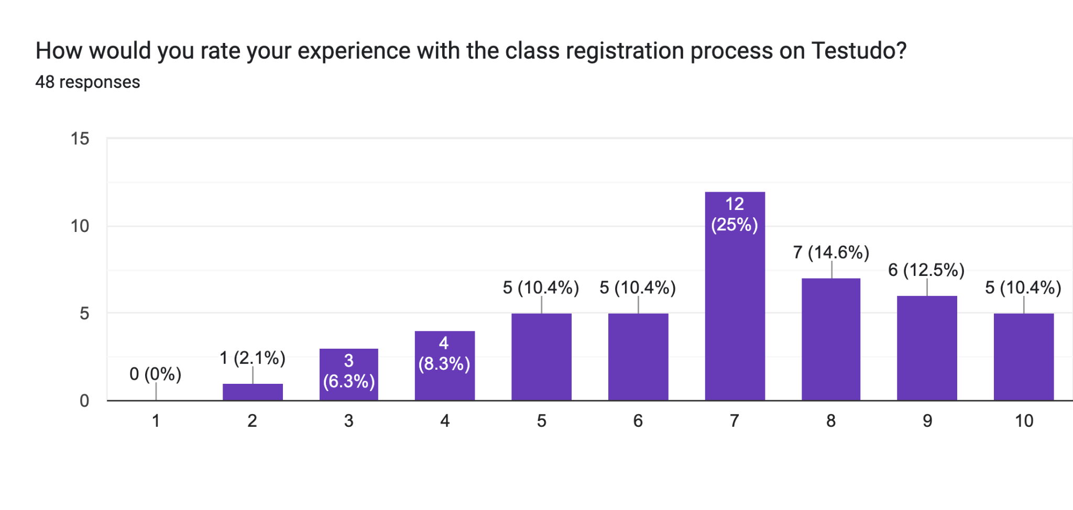
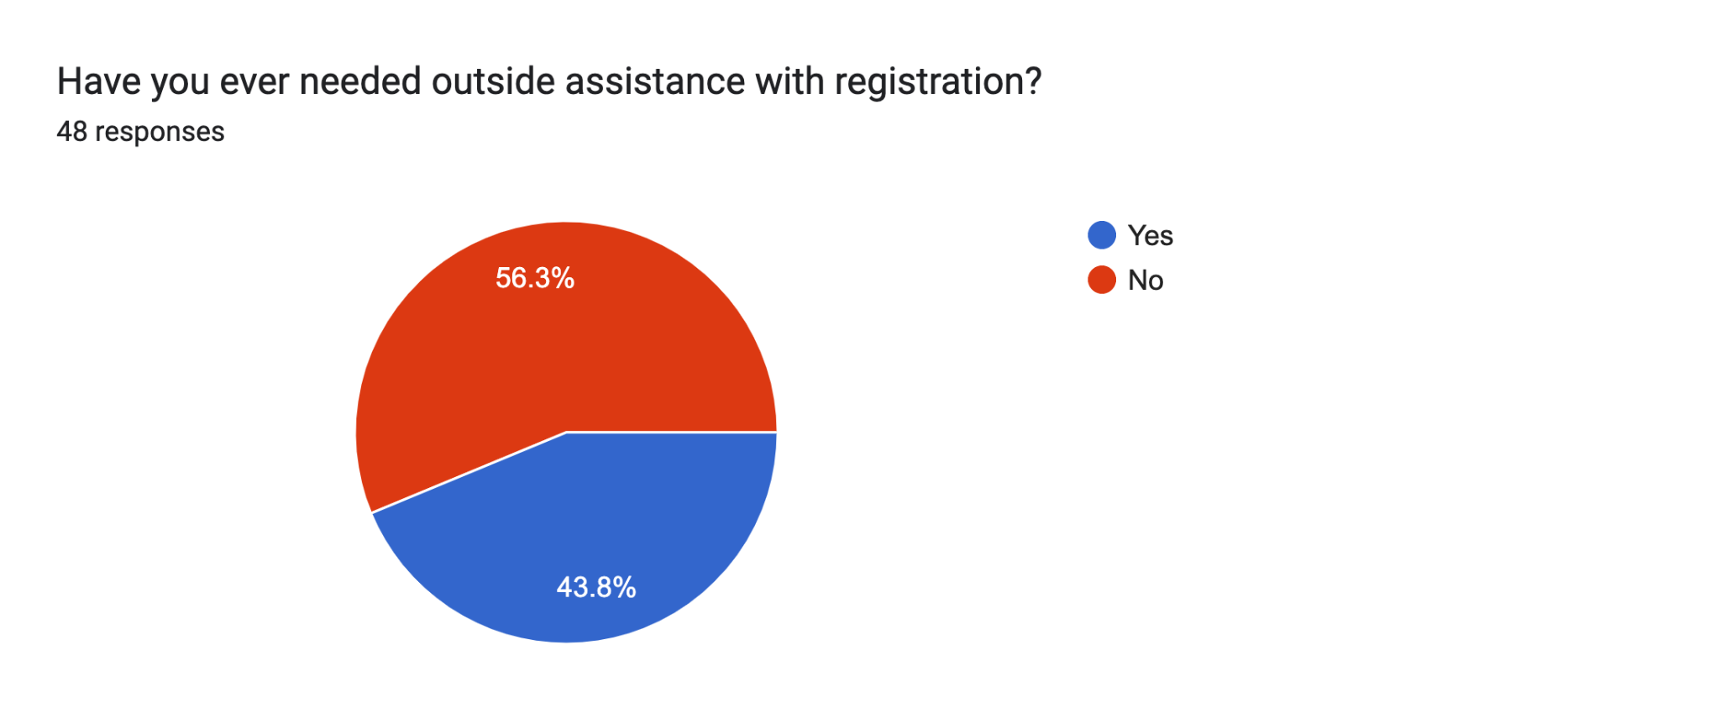
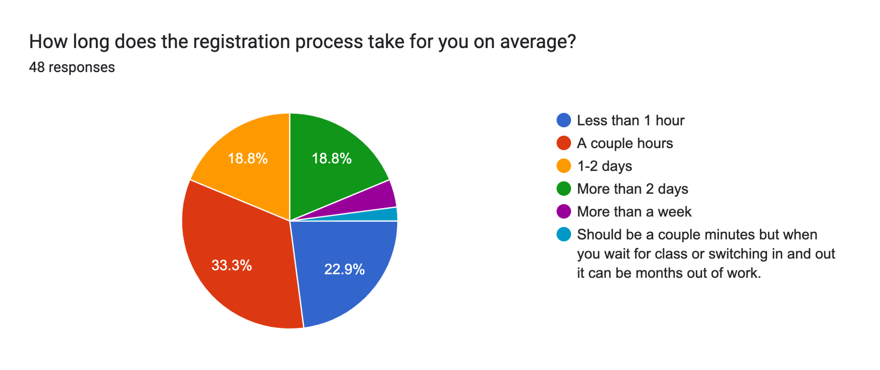
Survey Results

Slide 21
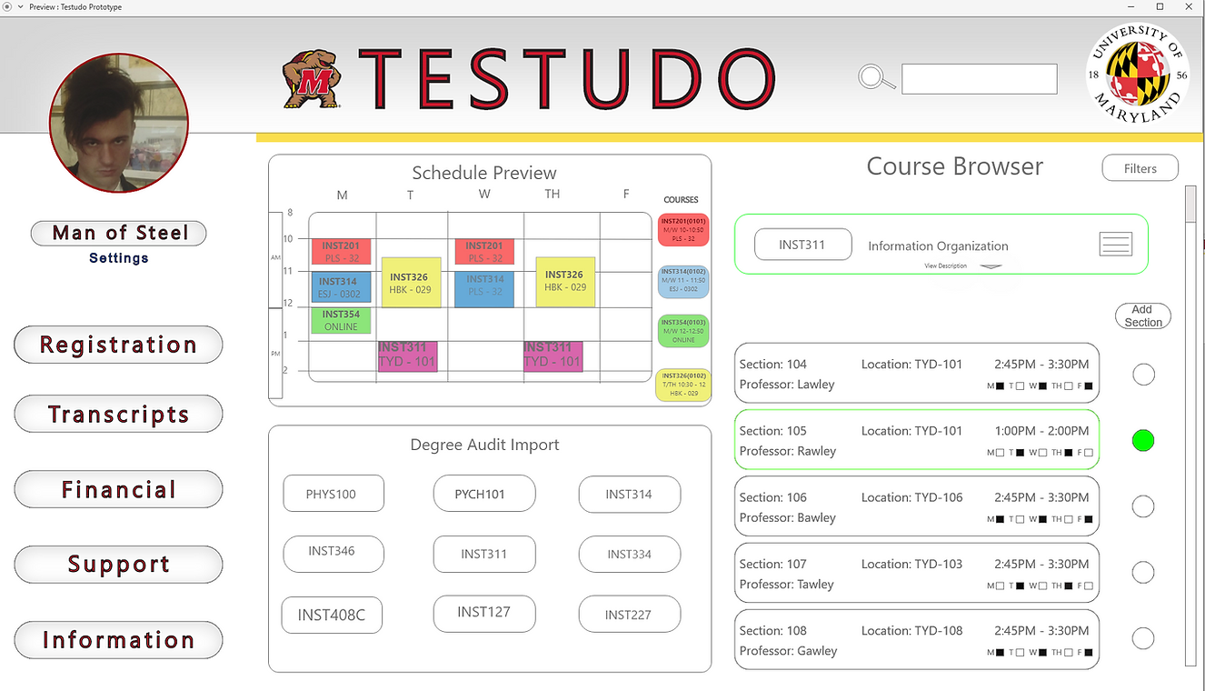
Prototype

Slide 22
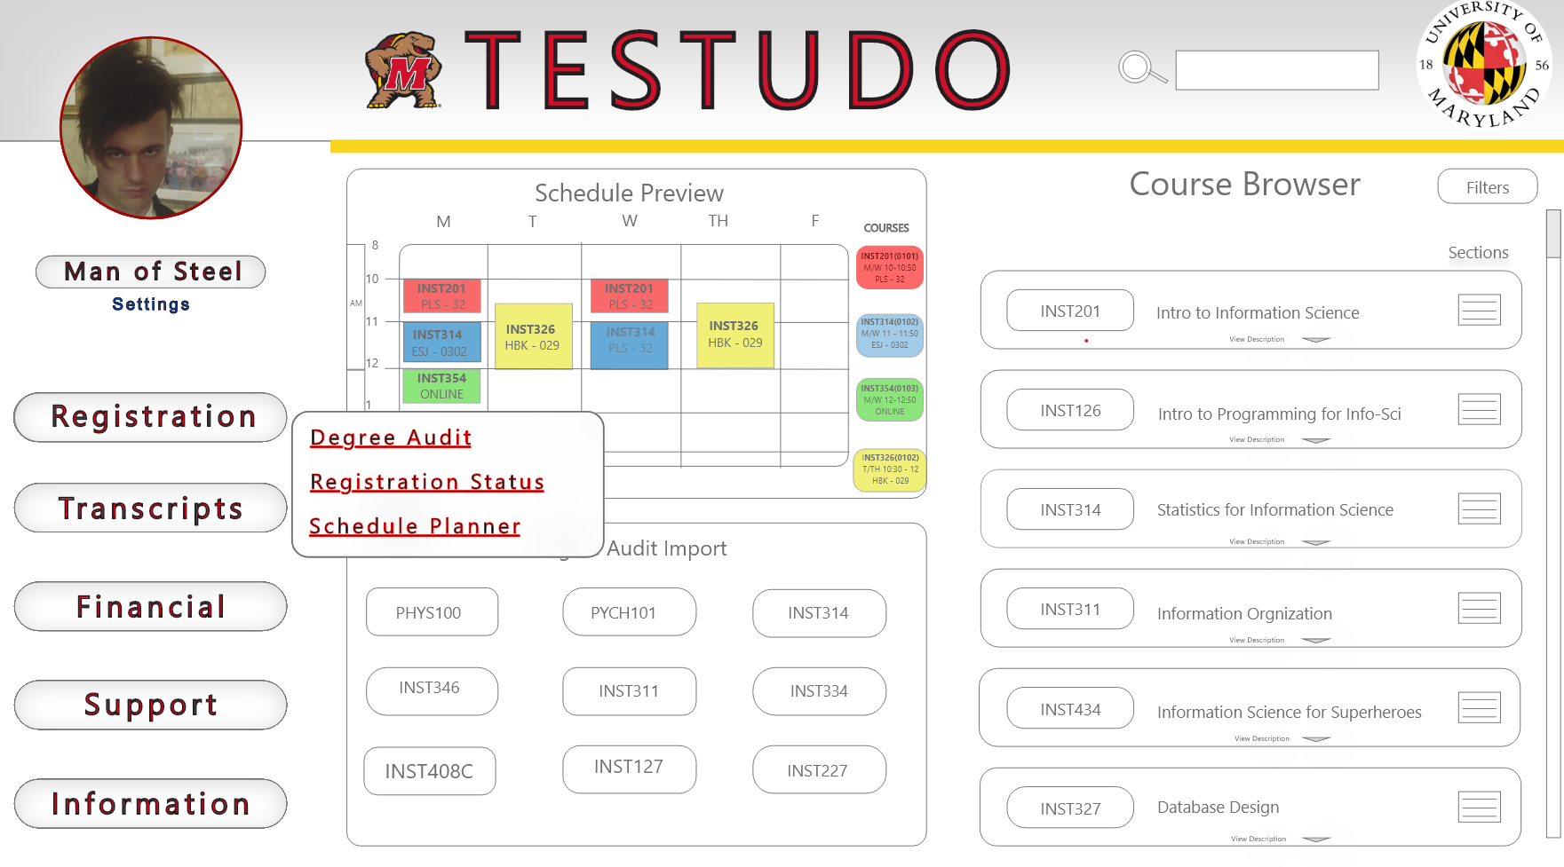
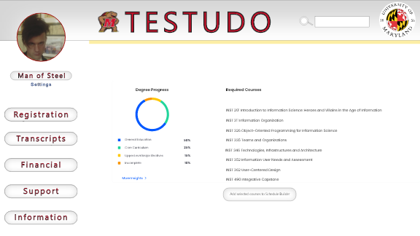
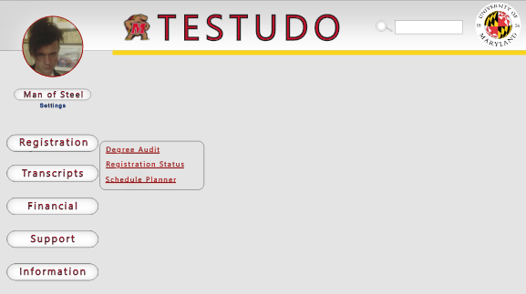
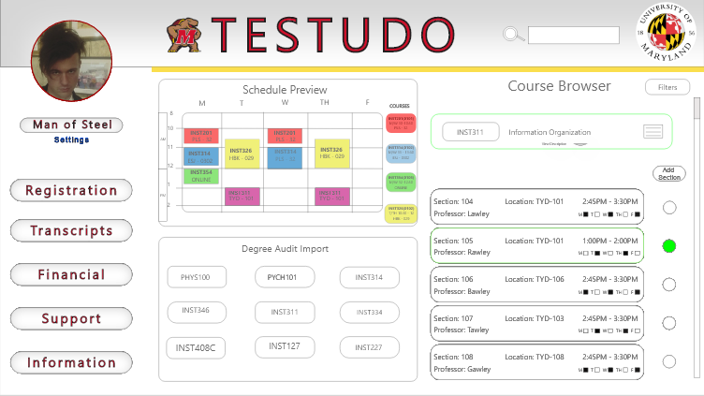





Testing
Tasks
Navigate to the degree audit page
2. Register for INST311 section 0105

Slide 23
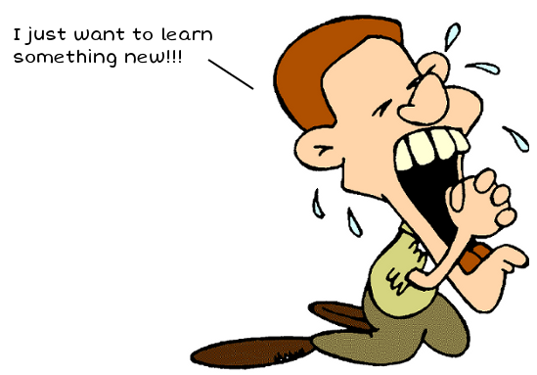
Testing
What we wanted to learn
Is our prototype intuitive?
How long is it taking compared to how long it should take?
Are people clicking in the wrong places? If so why?
How does it compare to the current version of Testudo?
What are the goods and bads on our prototype?
What should we add and what should we change?

Slide 24
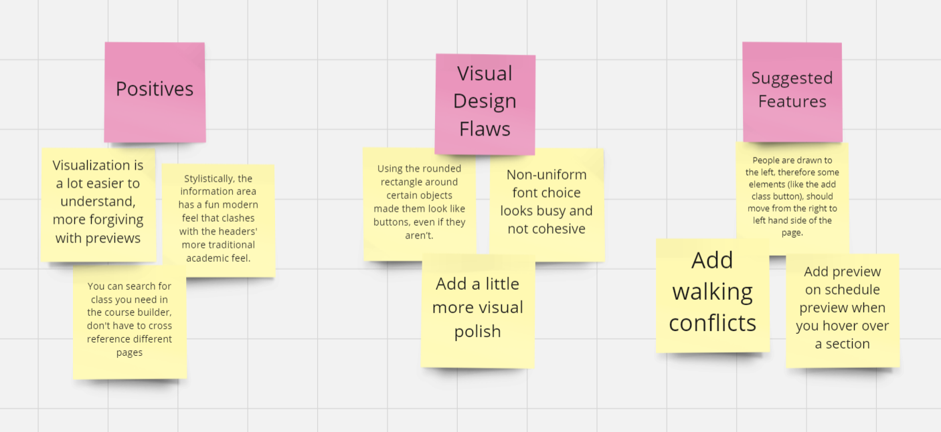
Feedback and Analysis

Slide 25
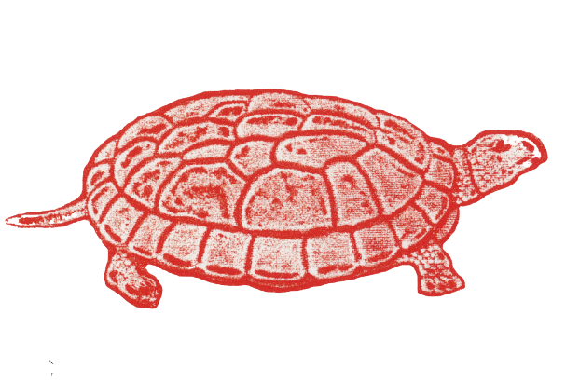
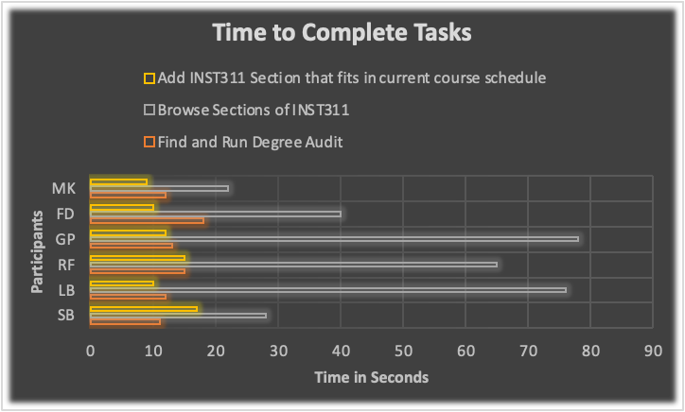
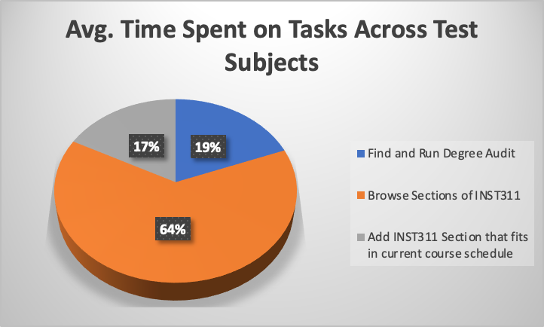
Graphics
Most time was spent browsing sections for a class that fit in their schedule.

Slide 26
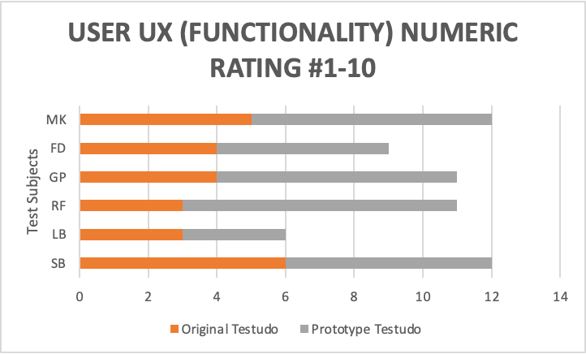

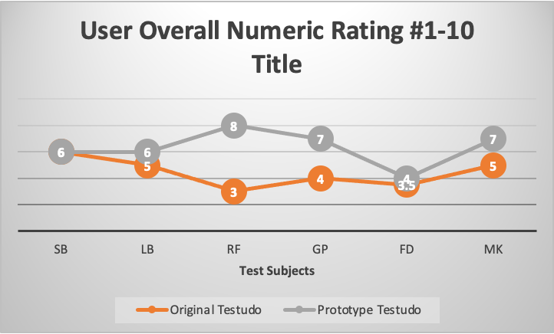
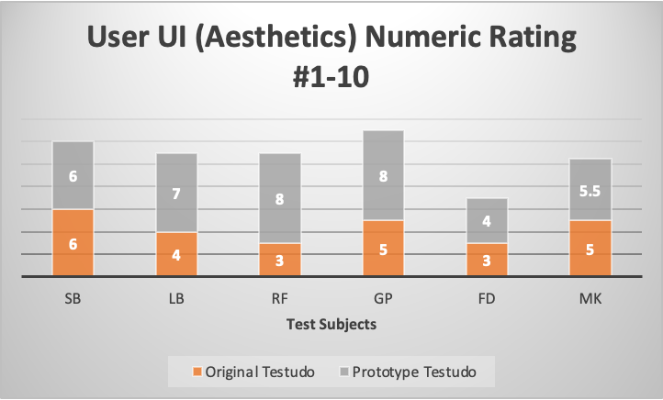
Charts

Slide 27
Findings
Most users rated our new interface higher than the original Testudo.
It is quicker for students to register on our interface.
“Schedule Builder” should be renamed schedule of classes
Our website's layout is not as intuitive as we first believed.
Removing the rounded bubbles from objects we don’t want people to be drawn to interact with, would make a more intuitive User Interface.

Slide 28

Conclusion
Our research shows that students are unhappy with the current Testudo registration process.
After designing a prototype using the user-oriented design process, students responded positively to our ideas.
Further interviews, prototypes, and testing would let us continue to improve the registration process.

Slide 29

Thank you.
Any Questions??

